Slide 1
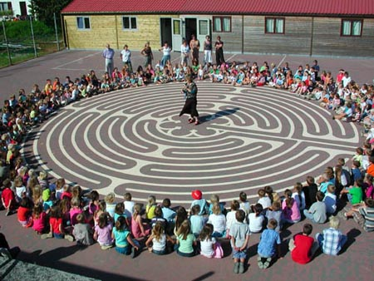
The turns of the labyrinth

Slide 2
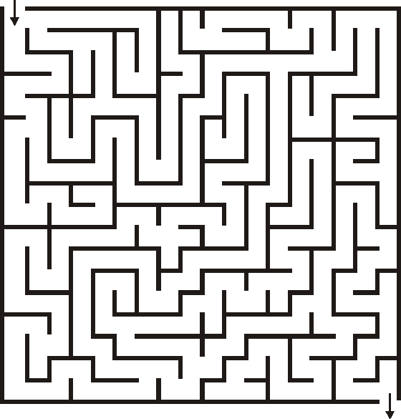
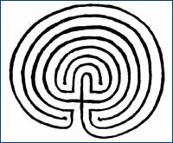
Not a maze!
no dead ends, no tricks
one path

Slide 3
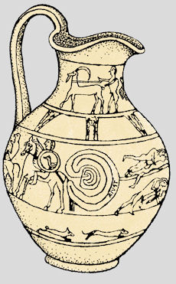
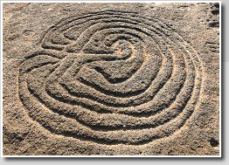
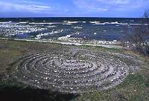
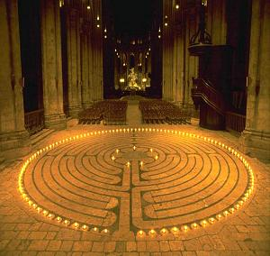
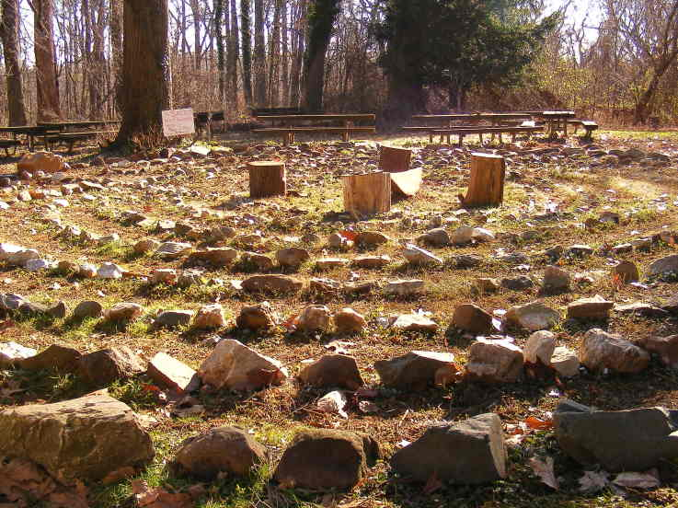
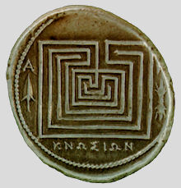
In cultures around the world for thousands of years, it is not new!
Nyhamn, Gotland, Sweden
Tragliatella Vase, Italy, c.650 BCE
Pansaimol, India, Neolithic?
Sacred Hopi Labyrinth
Coin from Knossos, Crete, c.280BCE
The Chartres Cathedral Labyrinth

Slide 4
Goals
Reflection tool
Tool to calm down
Tool for concentration
Beautiful place to be
It is in schools a relatively new development.
Pressure is high: succeed at school, excellent at sports, be popular, after-school activities and please their parents and teachers.

