Slide 1
Cultural facts
By malina gorea

Slide 2
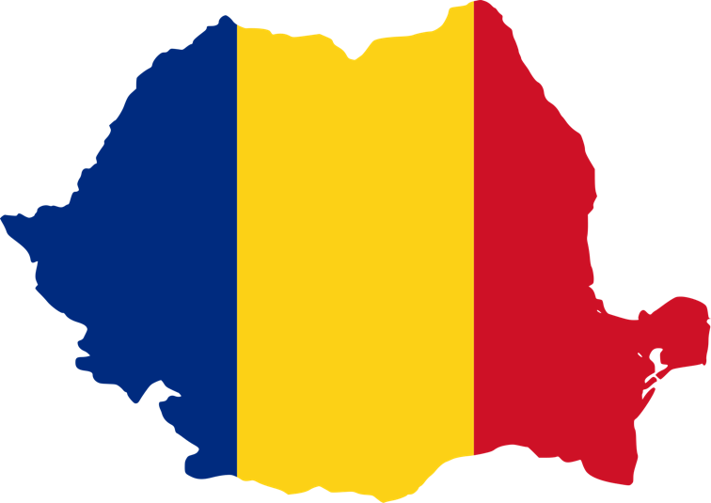
romania:

Slide 3
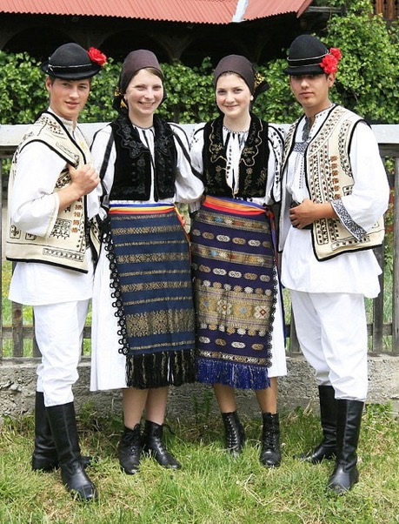
Folk costume:

Slide 4
Men’s clothing
The ițari are typical for Moldovans and represent a pair of long peasant trousers that were sewn from țigaie (a special breed of sheep wool). They were worn during the summer and the winter. Ițarii for summer wear are made of pânză de sac (bulky cotton).
The cioareci are peasant pants of white woollen cloth (dimie, pănură or aba) woven in four threads, therefore thicker than the ițari.
The oldest type of footwear is peasant sandals (opinci) worn with hemp canvas, woollen or felt foot wraps (obiele) or woollen socks (călțuni). Evidence for this style of footwear can be seen on a clay foot found in Turdaș, dating from around 2500 BC.
Known often by various names locally, the pieptar is an embroidered sheepskin vest, made generally in two styles, opened (spintecat) or close (înfundat), with the first being of normal front cut and the second one having a side open to be closed with buttons or taken over the head like a pullover.
Camasa is literally the Romanian word for shirt, and the variety of cuts and styles is overwhelming, varying greatly not only by area but also by age, status and occupation, only to be surpassed in variety by the women ones. Traditionally they were made of hemp or linseed linen, later of cotton.
The suman is a long peasant coat, a cold weather garment, worn by both sexes, usually knee-deep, in white, cream, brown, gray or black woolen cloth, decorated with warious decorated with găitane.
Of great importance was the girdle, their thick belt made of leather in case of chimir or woven textile in case of brau.
Hats: sheepskin hats, felt hats, straw hats

Slide 5
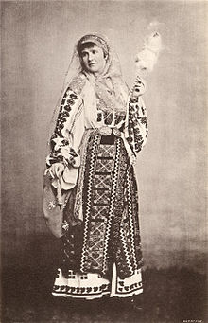
Women’s clothing
Ie is the type of shirt of a typical gathered form of the collar, which has existed since ancient times. It is also known as the "Carpathian shirt", similar to the Slavic (Bulgarian, Serbian, Ukrainian, etc.) peoples.
The fotã is a richly ornamented wrap-around skirt made out of a rectangular piece of woolen fabric worn at the waist. Alternately, it can be made of two pieces of woven material that cover the front of the body (like an apron) and the back.
Among the elements that should not miss in women's clothing are the "head coverings". They have a great aesthetic and social value for women. Young girls accustom to walk bareheaded, but after the wedding ritual – "bride's binders", "bride undressing" – the godmother puts her a beautiful basma or maramă.

Slide 6
Culture of Romania:
The culture of Romania is a unique culture, which is the product of its geography and its distinct historical evolution.
A feature of Romanian culture is the special relationship between folklore and the learned culture, determined by two factors. First, the rural character of the Romanian communities resulted in an exceptionally vital and creative traditional culture.

Slide 7
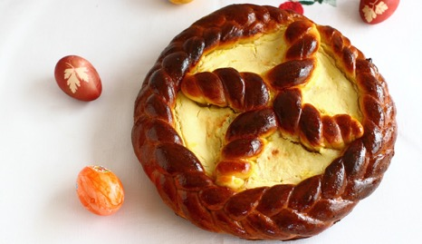
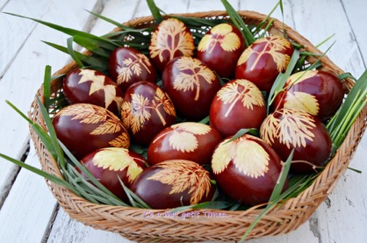
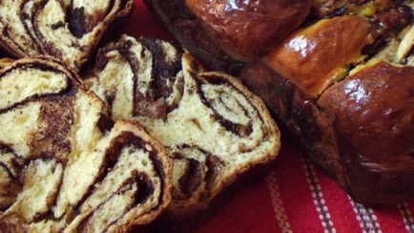
Easter:
Easter is the most important celebration of the Romanian people and it is preceded by numerous preparations and rituals.

Slide 8
Christmas:
Christmas is the first celebration from the cycle of New Year celebrations. In Romania it is being celebrated on the 25th of December.
Regarding the Christmas holidays, an interesting tradition is caroling. The carols are songs with which the people greet the coming of Christ on earth.

Slide 9
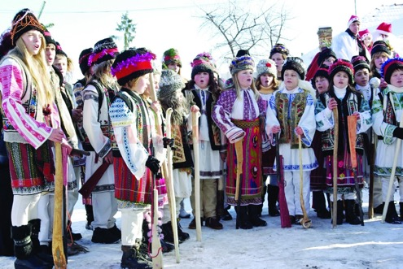
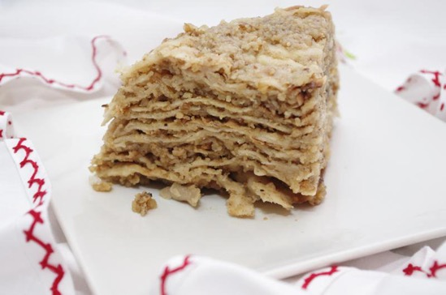

Slide 10
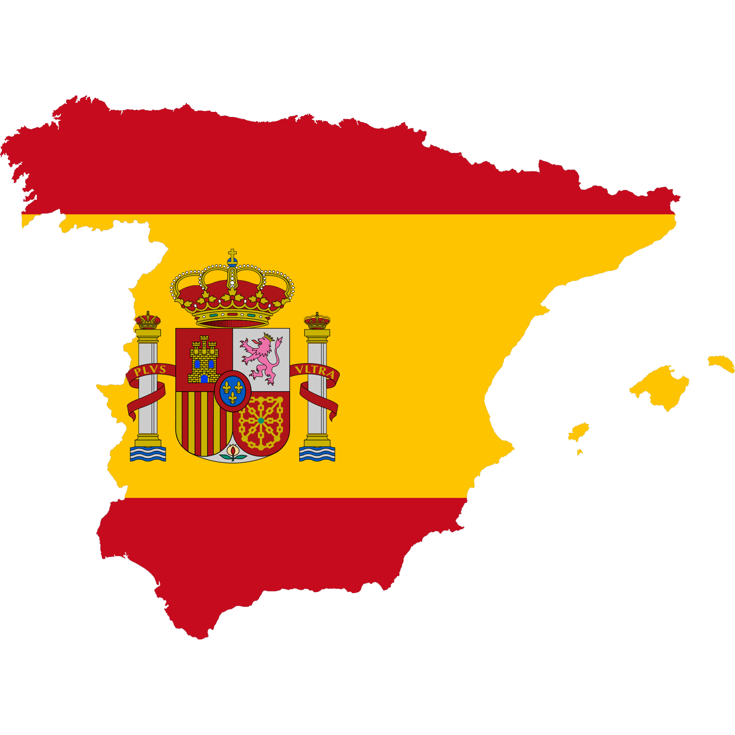
SPAIN TRADITIONS

Slide 11
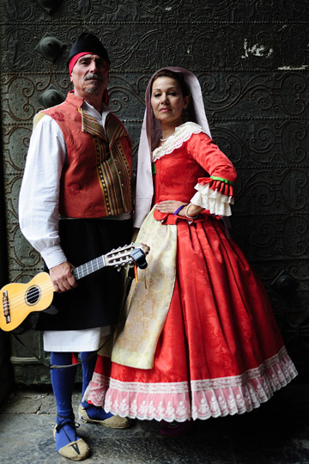
FOLK COSTUME:
Most traditional Spanish clothing is reserved for special events and celebrations. The most common pieces, still used today, include: the mantilla, the peineta and the gilet. The mantilla is a traditional Spanish veil piece that is often worn during religious celebrations such as Spanish weddings. It is a light lace or silk scarf that is worn over the head or shoulders on a high comb and held in place by pins. The peineta is a large decorative comb placed in the hair to hold up the mantilla. It is usually tortoiseshell colored with a curved body and long prongs to increase the height. The peineta, used on special occasions, originated centuries ago making it a traditional piece of Spanish clothing. Gilet: The word gilet comes from the Spanish word jileco (from Arabic word yalíka), or chaleco in modern Spanish. It is a sleeveless jacket, much like a waistcoat or vest that forms an important part of traditional Spanish clothing. Historically they were fitted and embroidered and in the 19th century the gilet was a bodice shaped like a man’s aistcoat. Contemporary gilets are used for additional warmth outdoors. In the first edition of El Quijote, in 1605, a diminutive of the word appeared: gilecuelo.

Slide 12
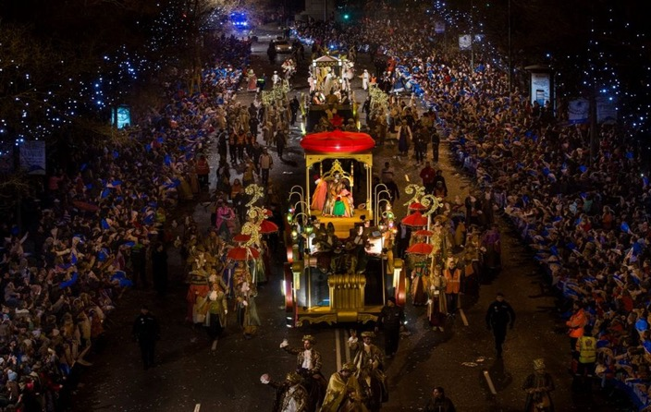
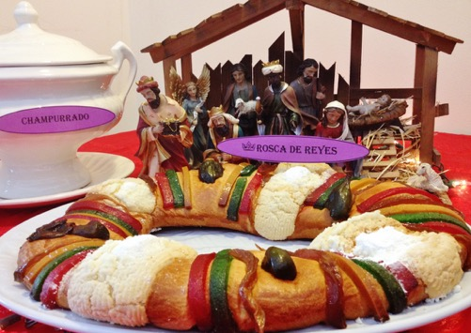
El dia de Los reyes:
“Día de los Reyes” commemorates the visit of the three kings or the Magi to Baby Jesus;
Rosca de reyes:

Slide 13
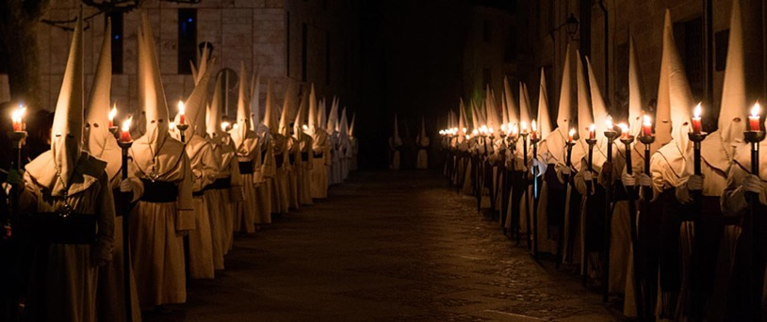
EASTER:
Locally known as Semana Santa (Holy Week), Easter is the most important celebration in Spain, and stands out for its epic brotherhoods’ processions and unique, age-old traditions specific to each region.

Slide 14
NEW YEAR:
As the clock ticks down to midnight on New Year’s Eve, revelers across Spain pack into their city’s main plazas or into their family’s living room to watch the clock chime midnight. As the hour draws near, every man, woman, child, grandma and grandpa will be clinging to twelve green grapes.

Slide 15
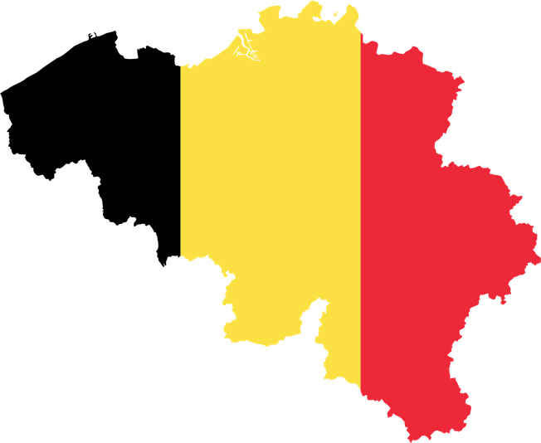
BELGIUM:

Slide 16
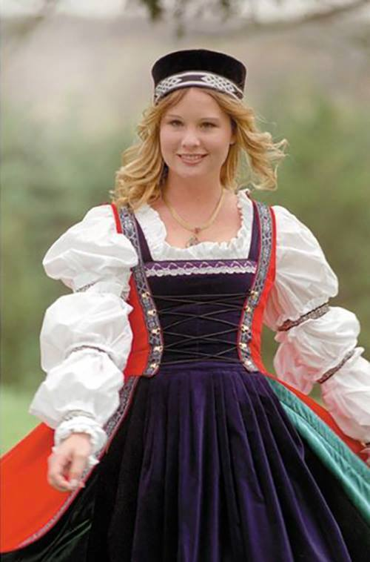
Folk costume:
The most famed and extravagant among Belgian costumes belongs to the “Gilles,” curiously masked figures who fill the streets of the Walloon town of Binche on Mardi Gras. In the afternoon, they pelt oranges at an excited crowd, but not before everyone has had a chance to awe at their vibrant, yellow-and-orange-striped costumes, packed with straw and with patches of crowns and lions sewn on for a larger-than-life look.
another showy Belgian outfit that has persisted throughout the centuries is the “huntress,” an elaborate dress usually made for medieval ladies of means. This most classic of gowns had large, flaring sleeves as its most striking feature, often embroidered around the edges with decorative Celtic trimming. The attractive way it flows still compels some brides to select it as their dress for a folkloric-themed wedding these days, and it wouldn’t be uncommon for such a happening to feature bridesmaids wearing eponins.
As for the general populace, smocks and berets were the preferred fashion among men until suits came into play in the 19th century. Before Belgium claimed its independence in 1830, tastes were mostly governed by the French occupiers. Boys in tunics with pantalettesunderneath were a regular sight until well into the 19th century, and all young kids, including boys, wore dresses until the 20th century. Over in rural Flanders, black dresses with white aprons over them signaled a certain Dutch influence, but last century, the farmer’s wives of the Kempen, part of the Antwerp province, were dressing mainly in wide skirts and white caps. A large shawl almost resembling a blanket was often thrown over the shoulders, adding an extra matronly touch.
https://theculturetrip.com/europe/belgium/articles/an-introduction-to-belgian-traditional-dress/

Slide 17
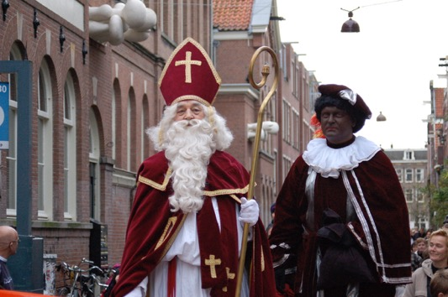
CHRISTMAS:
Children put their shoes in front of the fireplace, together something for Sinterklaas like a drawing or biscuits; they might also leave a carrot for Sinterklass's horse and something for Zwarte Piet (Black Peter, Sinterklass's assistant).

Slide 18
EASTER:
Easter is an important celebration in Belgium in remembrance of Christ’s resurrection. Besides that, as one of the world’s tastiest chocolate producers, Belgium is also where you can find some of the world's best chocolate eggs.
The best Easter parade in Belgium is arguably the horse-led parade Cavalcade de Herve. While the city of Herve in Wallonia is better known for its cheese, its parade on horseback attracts around 50,000 visitors each year.

Slide 19
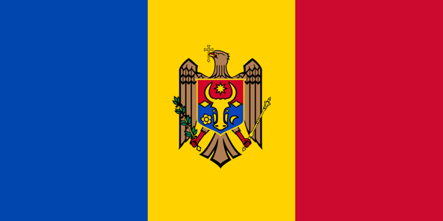
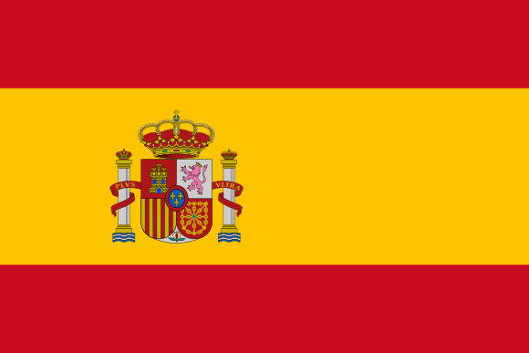
Thanks for your attention!!!

Slide 20
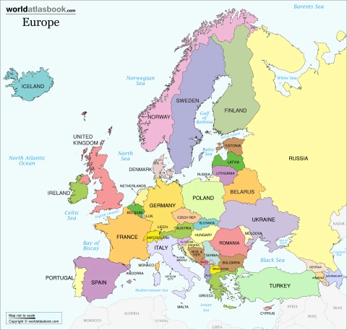
LANDMARKS
BELGIUM SPAIN ROMANIA

Slide 21
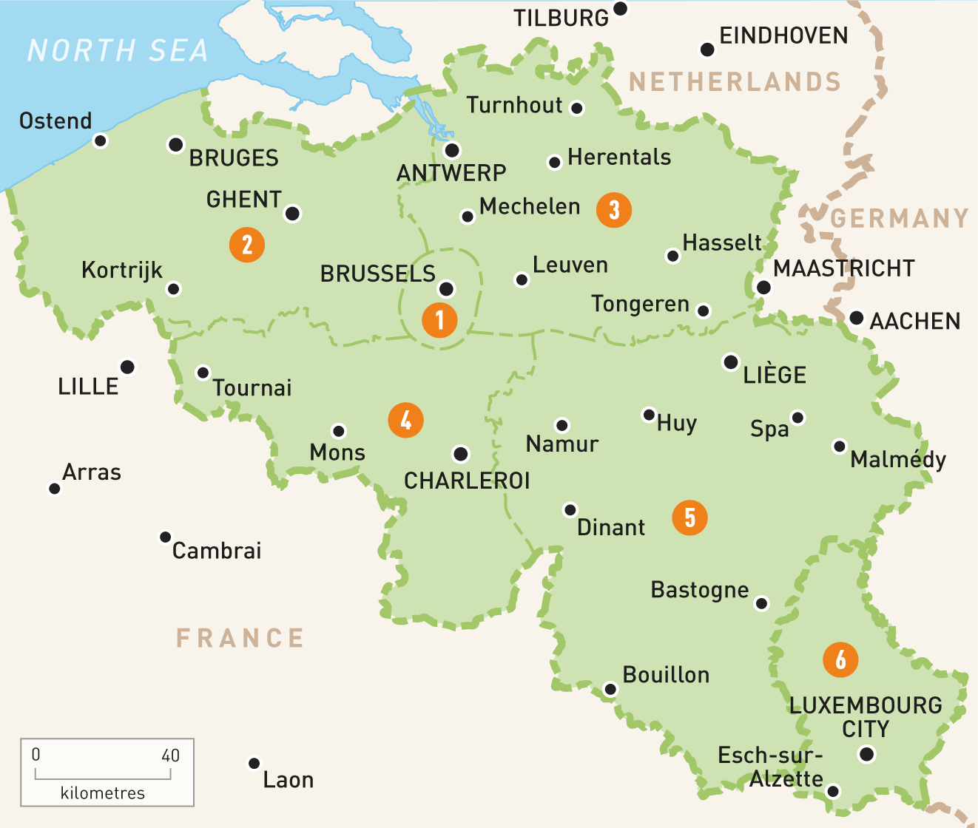
LANDMARKS - BELGIUM

Slide 22
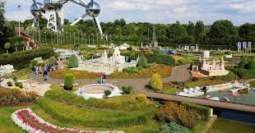
MINI-EUROPE
MINI-EUROPE is a miniature park located in Bruparck at the foot of the Atomium in Brussels, Belgium. Mini-Europe has reproductions of monuments in the European Union on show, at a scale of 1:25.

Slide 23
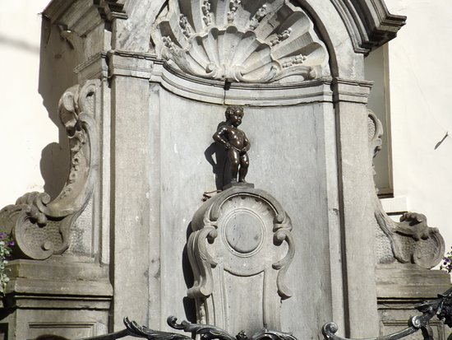
2. MANNEKEN PIS
Manneken Pis is a landmark small bronze sculpture in Brussels, depicting a naked little boy urinating into a fountain's basin. It was designed by Hiëronymus Duquesnoy the Elder and put in place in 1618 or 1619.

Slide 24
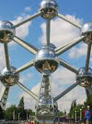
3. ATOMIUM
The Atomium is a landmark building in Brussels, originally constructed for the 1958 Brussels World's Fair. It is located on the Heysel Plateau, where the exhibition took place. It is now a museum.

Slide 25
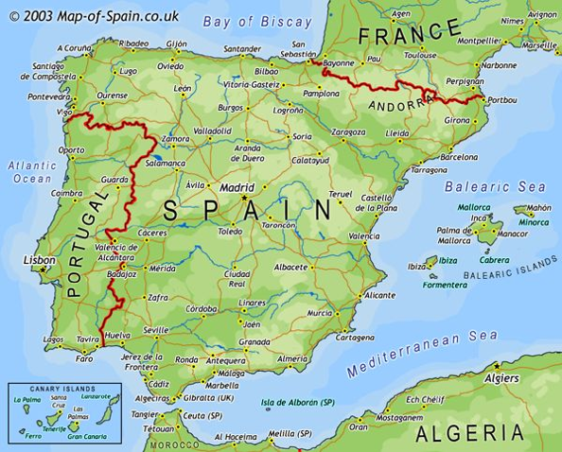
LANDMARKS - SPAIN

Slide 26
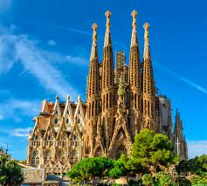
1.SAGRADA FAMILIA
Sagrada Família is a large unfinished Roman Catholic church in Barcelona, designed by Catalan architect Antoni Gaudí.

Slide 27
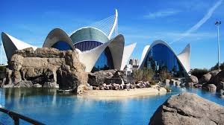
2. THE OCENOGRAFIC FROM VALENCIA
L'Oceanogràfic is an oceanarium situated in the east of the city of Valencia, Spain, where different marine habitats are represented. It was designed by the architect Félix Candela and the structural engineers Alberto Domingo and Carlos Lázaro. It is integrated inside the cultural complex known as the Ciutat de les Arts .

Slide 28
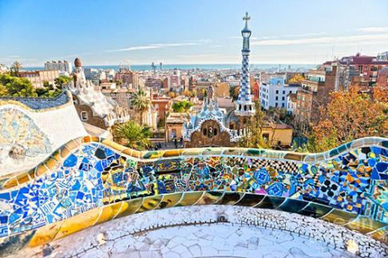
3. Park Güell
The Park Güell is a public park system composed of gardens and architectonic elements located on Carmel Hill, in Barcelona, Catalonia.

Slide 29
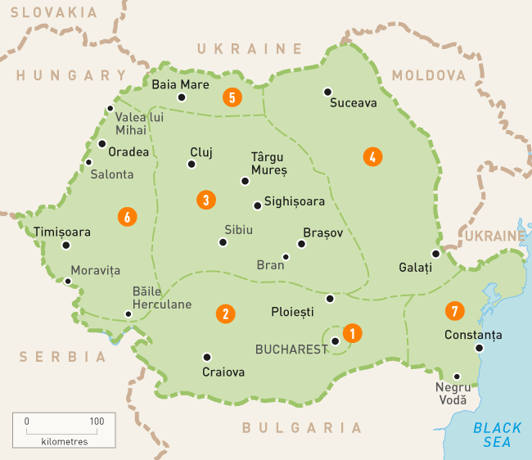
LANDMARKS - ROMANIA

Slide 30
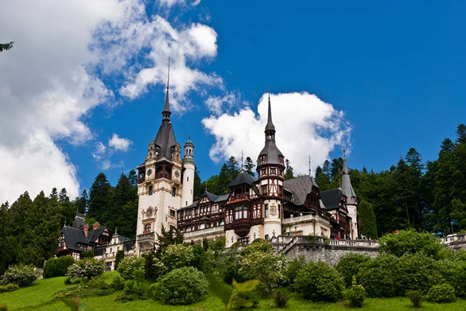
THE PELES CASTLE
Peleș Castle is a Neo-Renaissance castle in the Carpathian Mountains, near Sinaia, in Prahova County, Romania, on an existing route linking Transylvania and Wallachia, built between 1873 and 1914. Its inauguration was held in 1883. It was constructed for King Carol I.

Slide 31
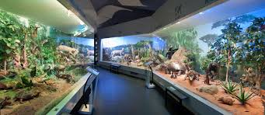
2. THE ANTIPA MUSEUM
At Antipa museum there are 2 million invertebrate and vertebrate specimens. The present headquarter buildings were designed and built at the initiative of Grigore Antipa, director of the museum between 1893 - 1944.

Slide 32
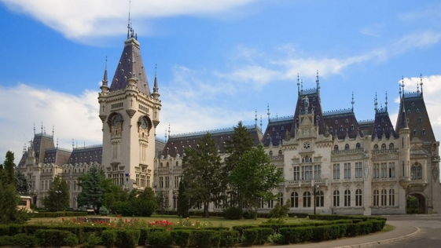
3. THE PALACE OF CULTURE
The Palace of Culture is an edifice located in Iași, Romania. The building served as Administrative and Justice Palace until 1955, when its destination was changed, being assigned to the four museums nowadays united under the name of Moldova National Museum Complex.

Slide 33
THANK YOU FOR YOUR ATTENTION!!!

